Slide 1


Slide 2
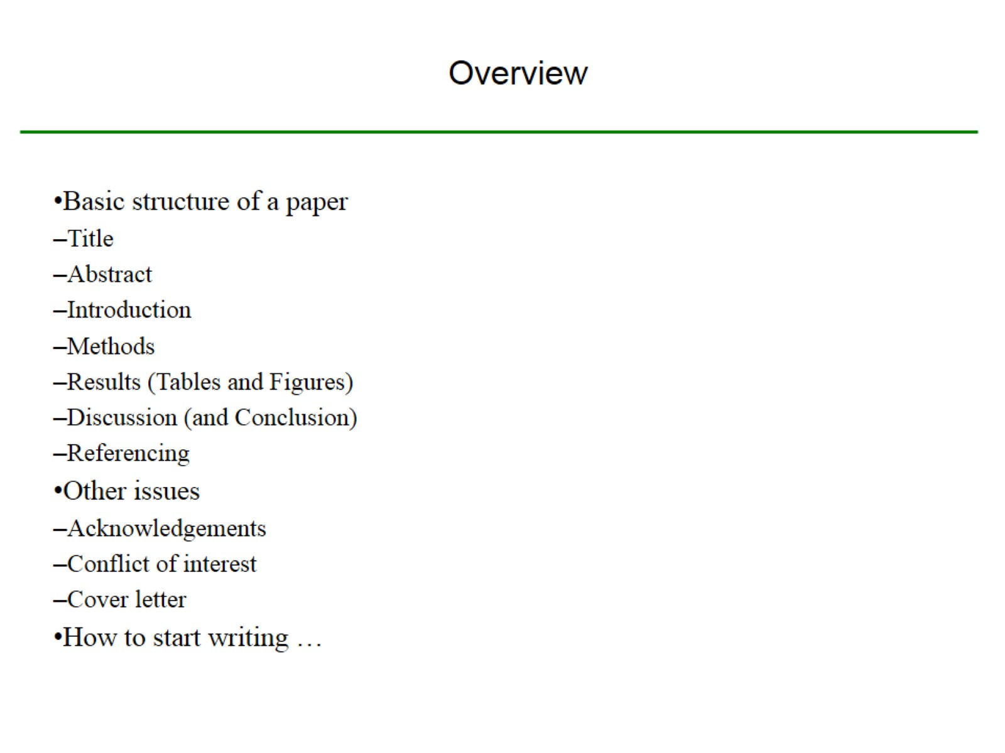
Overview

Slide 3
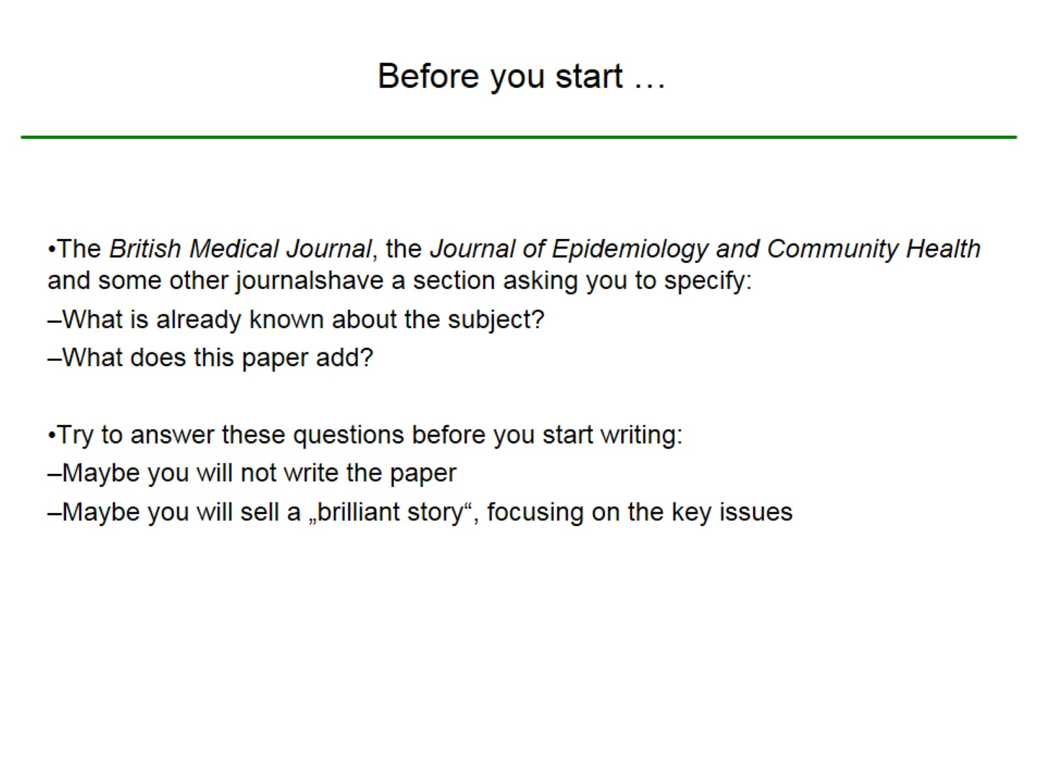
Before you start …

Slide 4
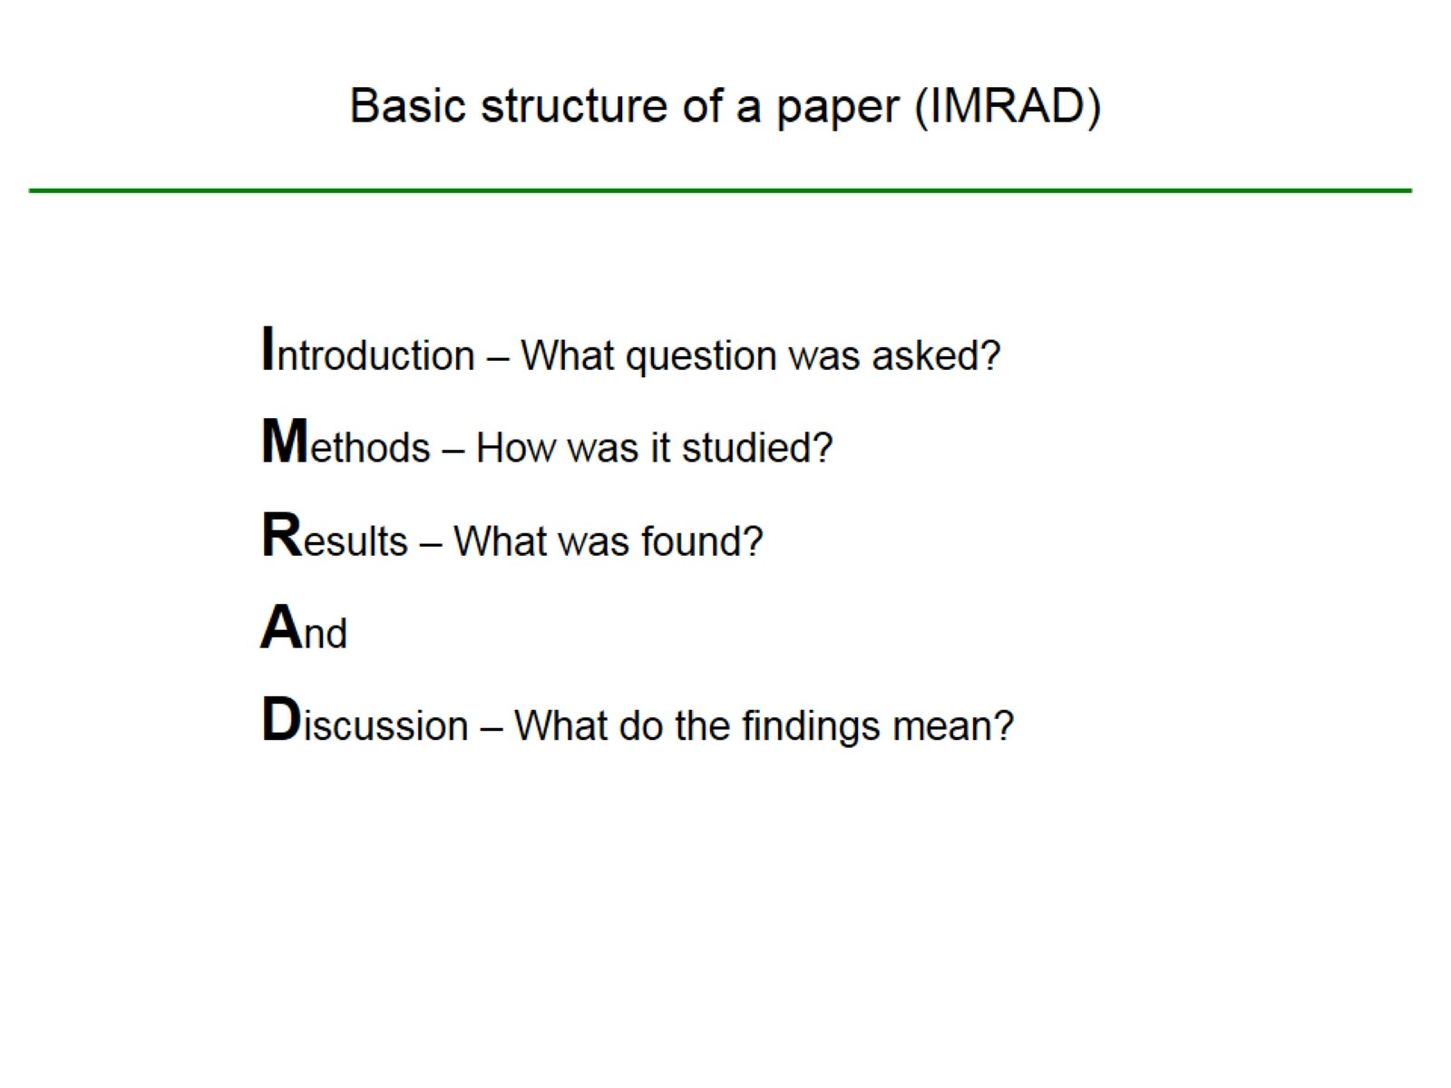
Basic structure of a paper (IMRAD)

Slide 5
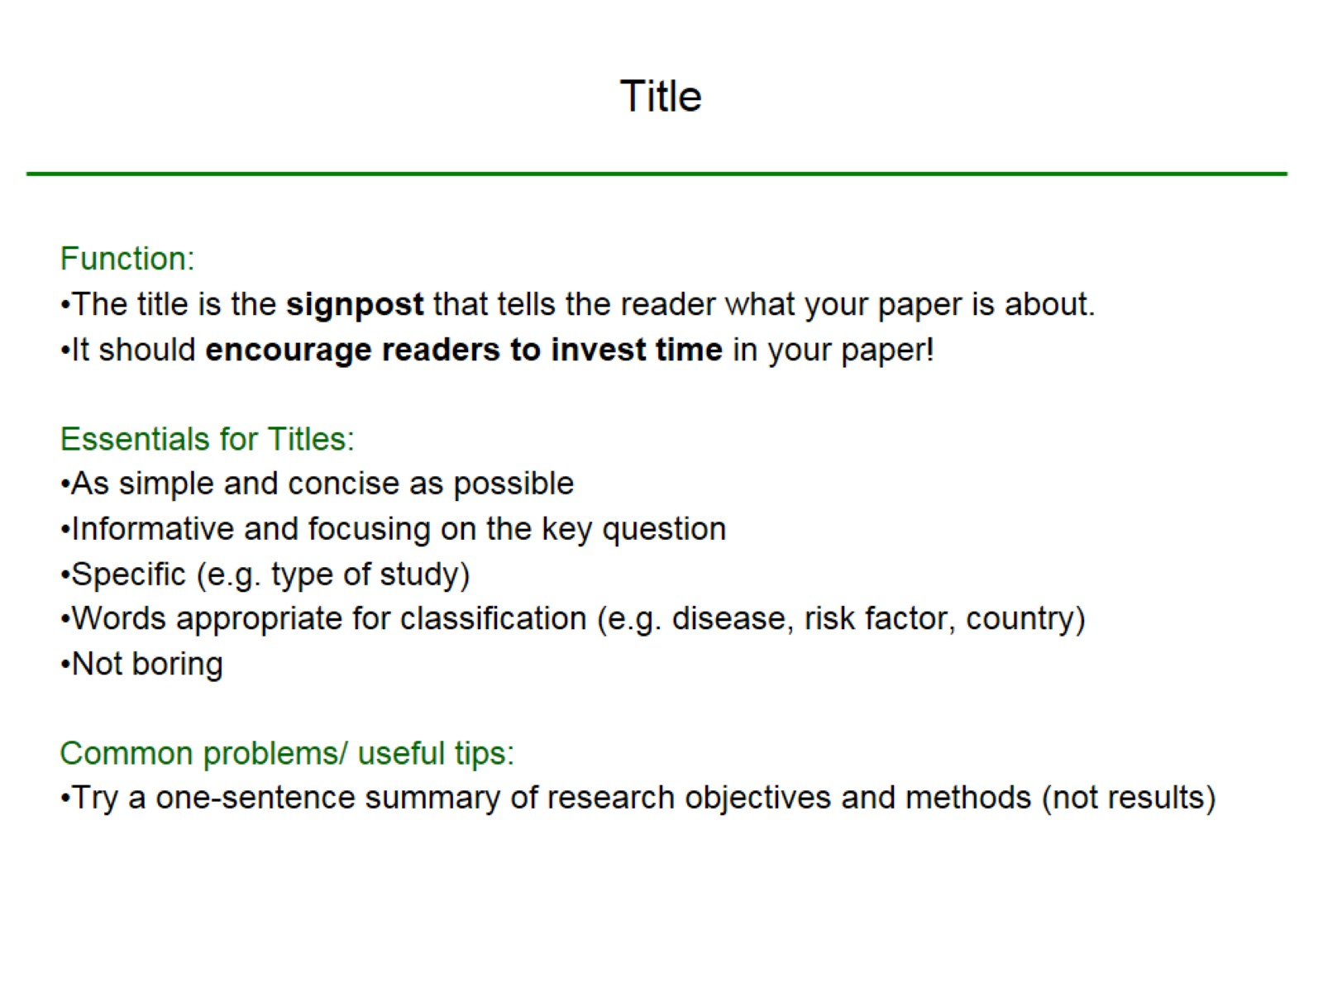
Title

Slide 6
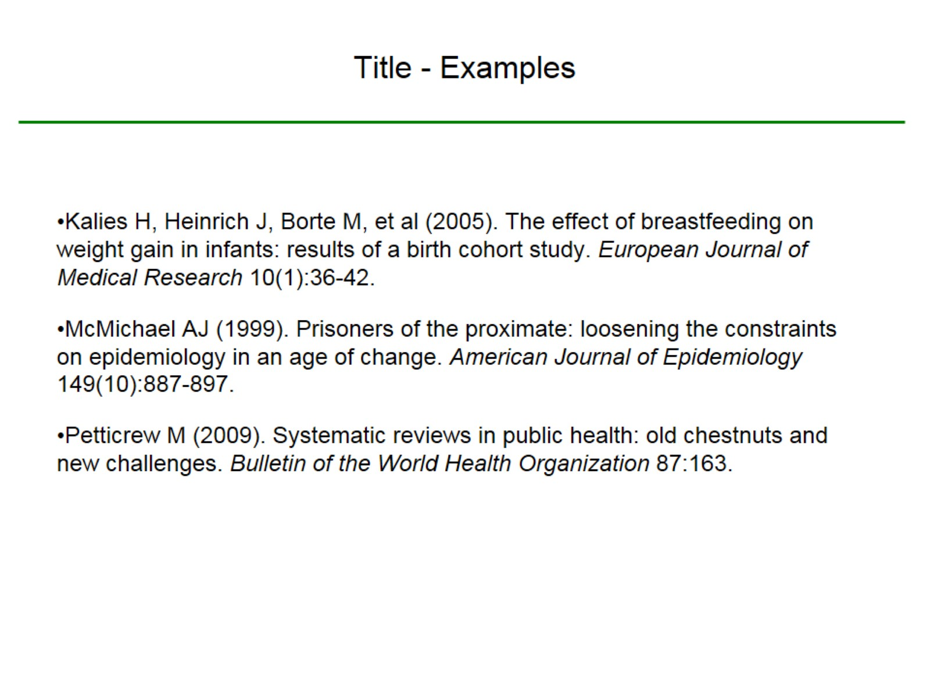
Title - Examples

Slide 7
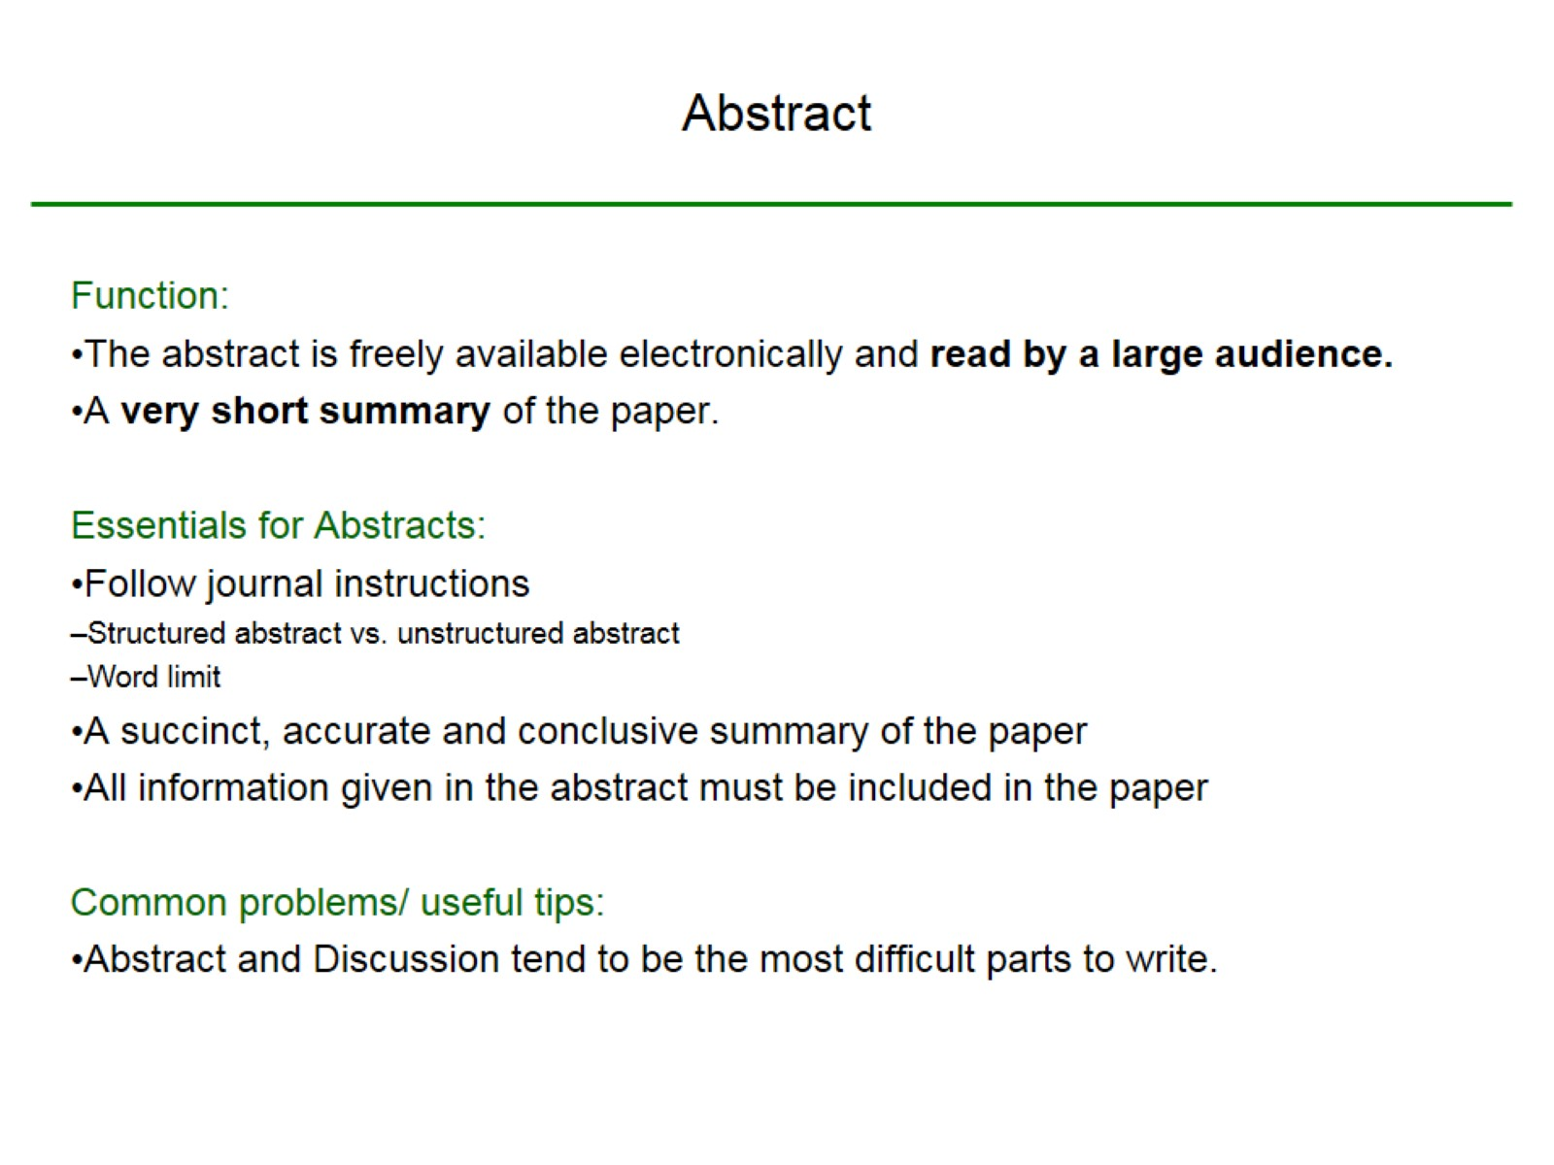
Abstract

Slide 8
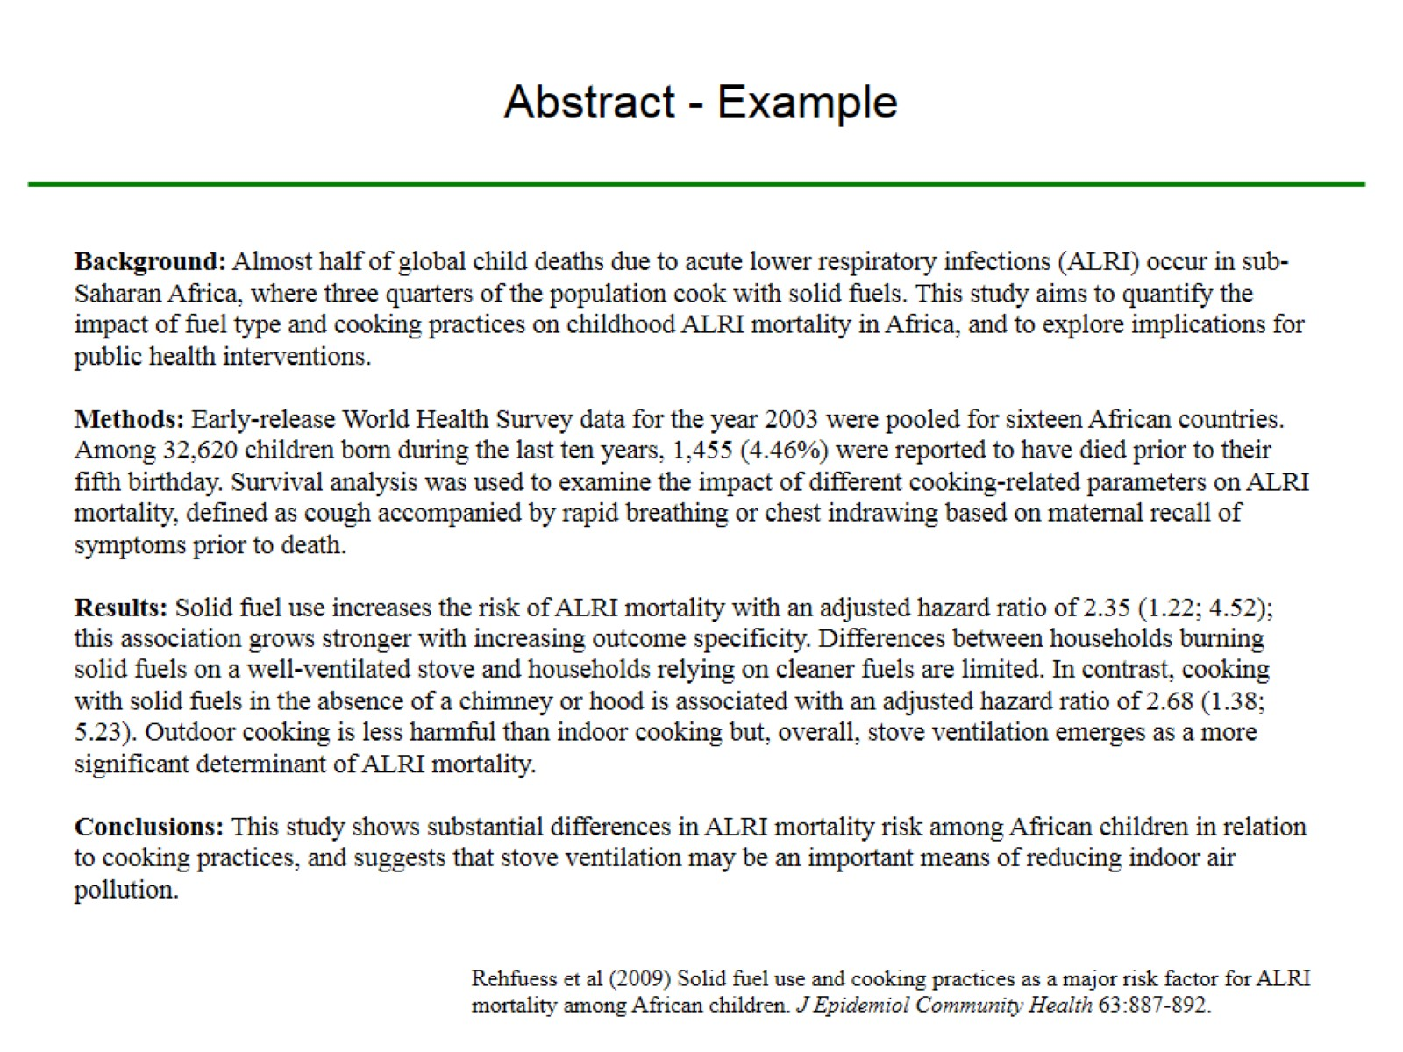
Abstract - Example

Slide 9
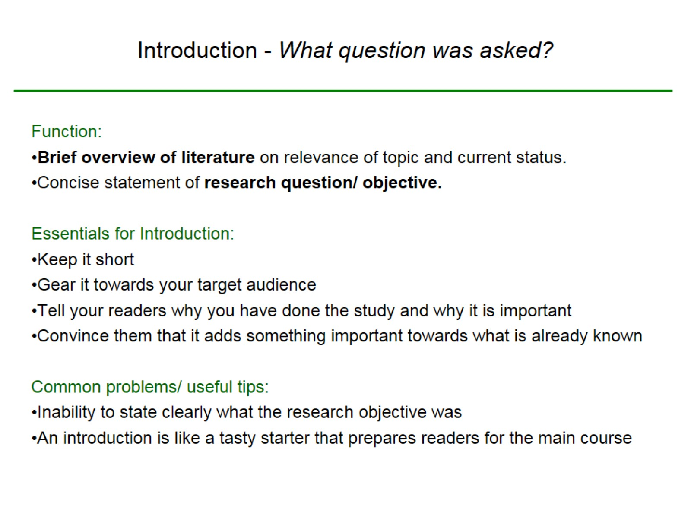
Introduction - What question was asked?

Slide 10
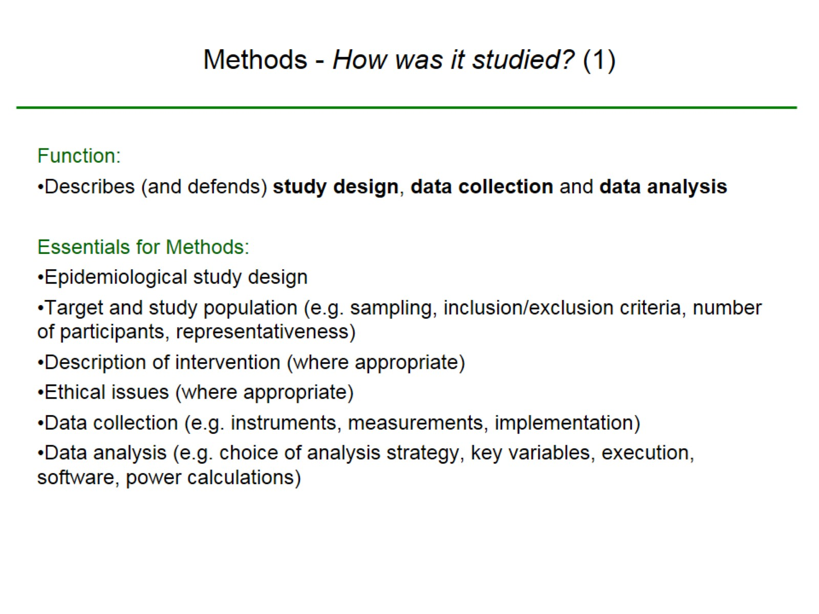
Methods - How was it studied? (1)

Slide 11
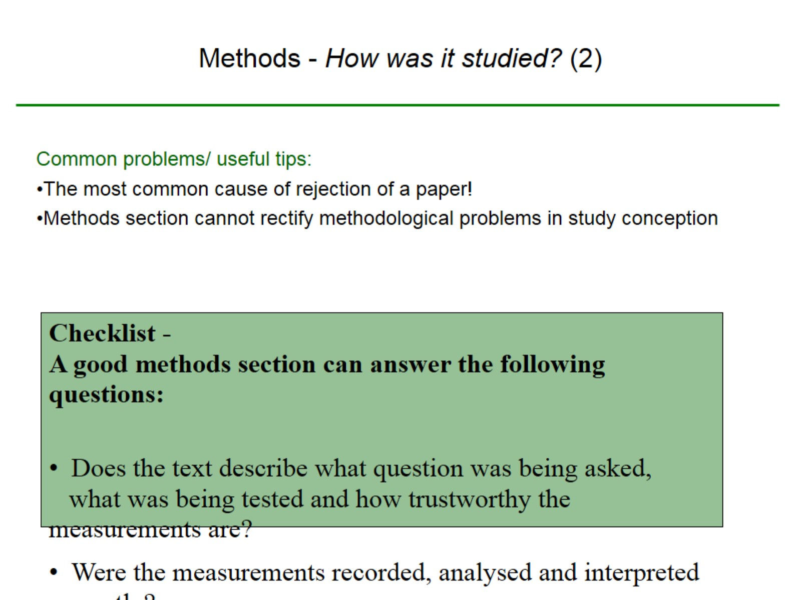
Methods - How was it studied? (2)

Slide 12
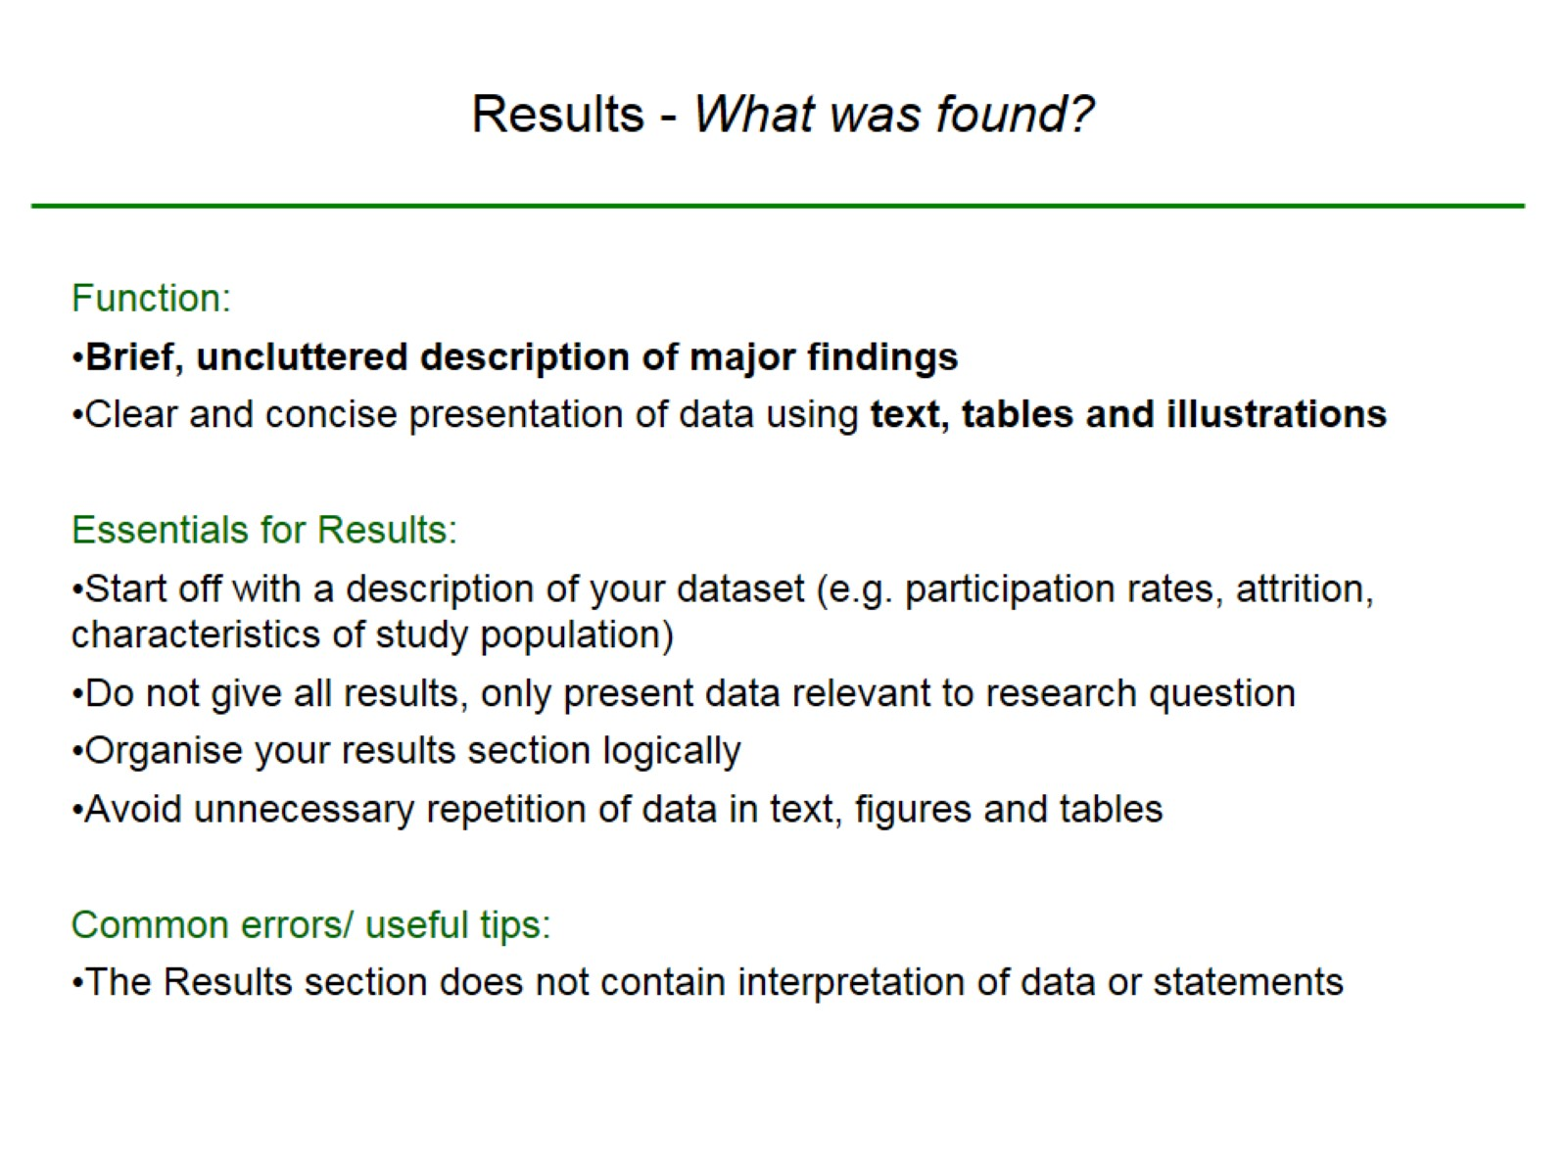
Results - What was found?

Slide 13
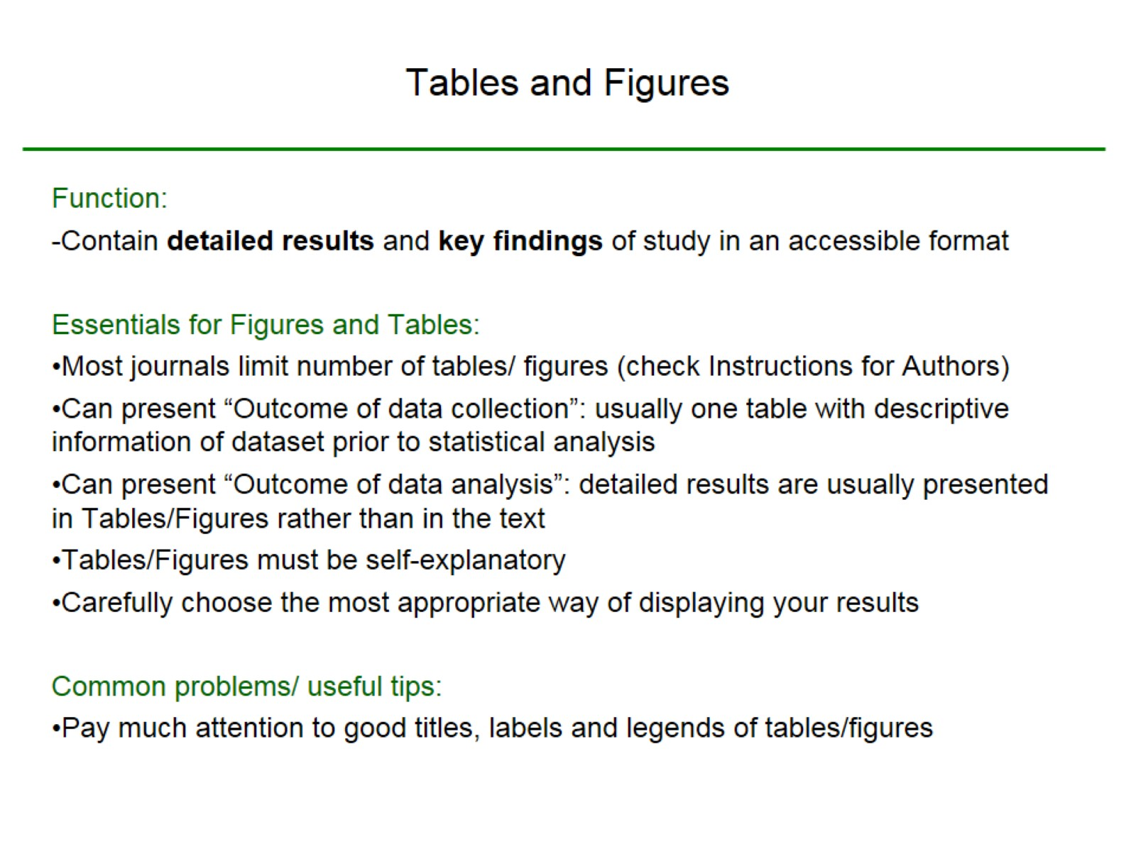
Tables and Figures

Slide 14
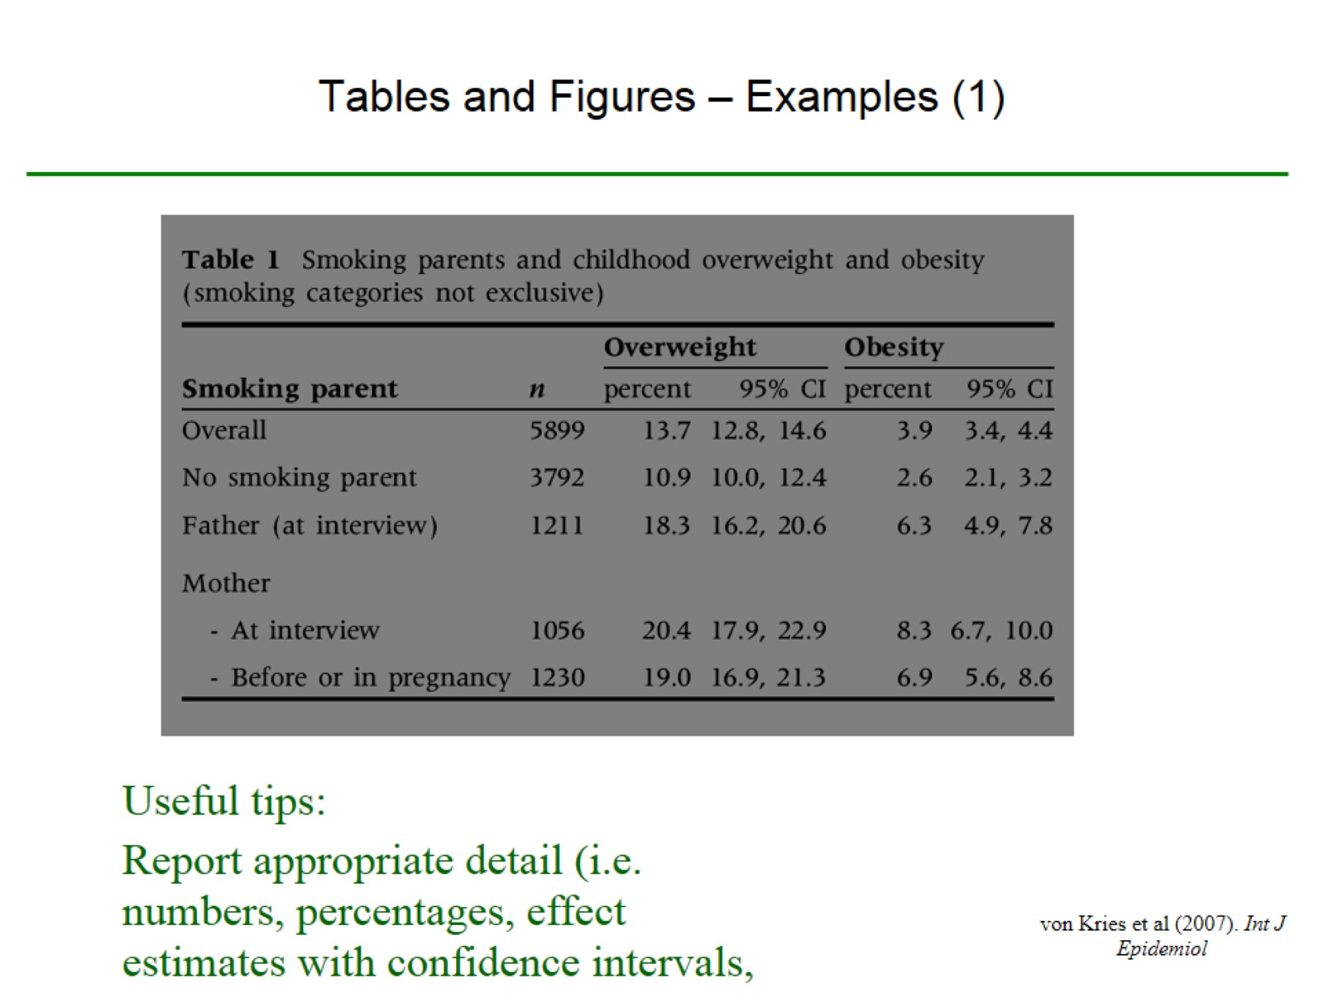
Tables and Figures – Examples (1)

Slide 15
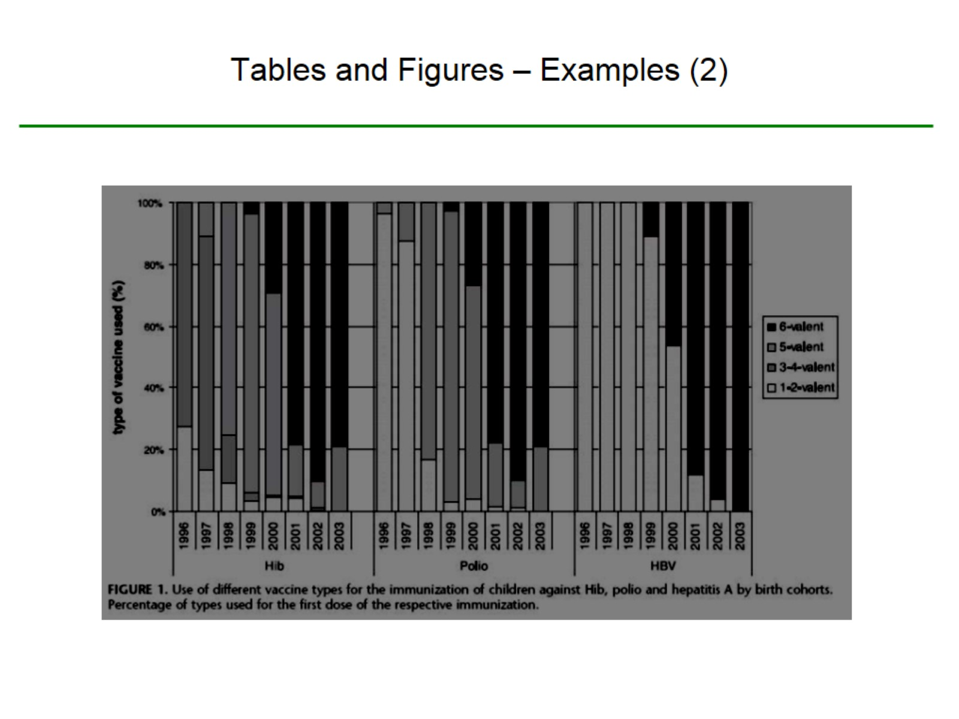
Tables and Figures – Examples (2)

Slide 16
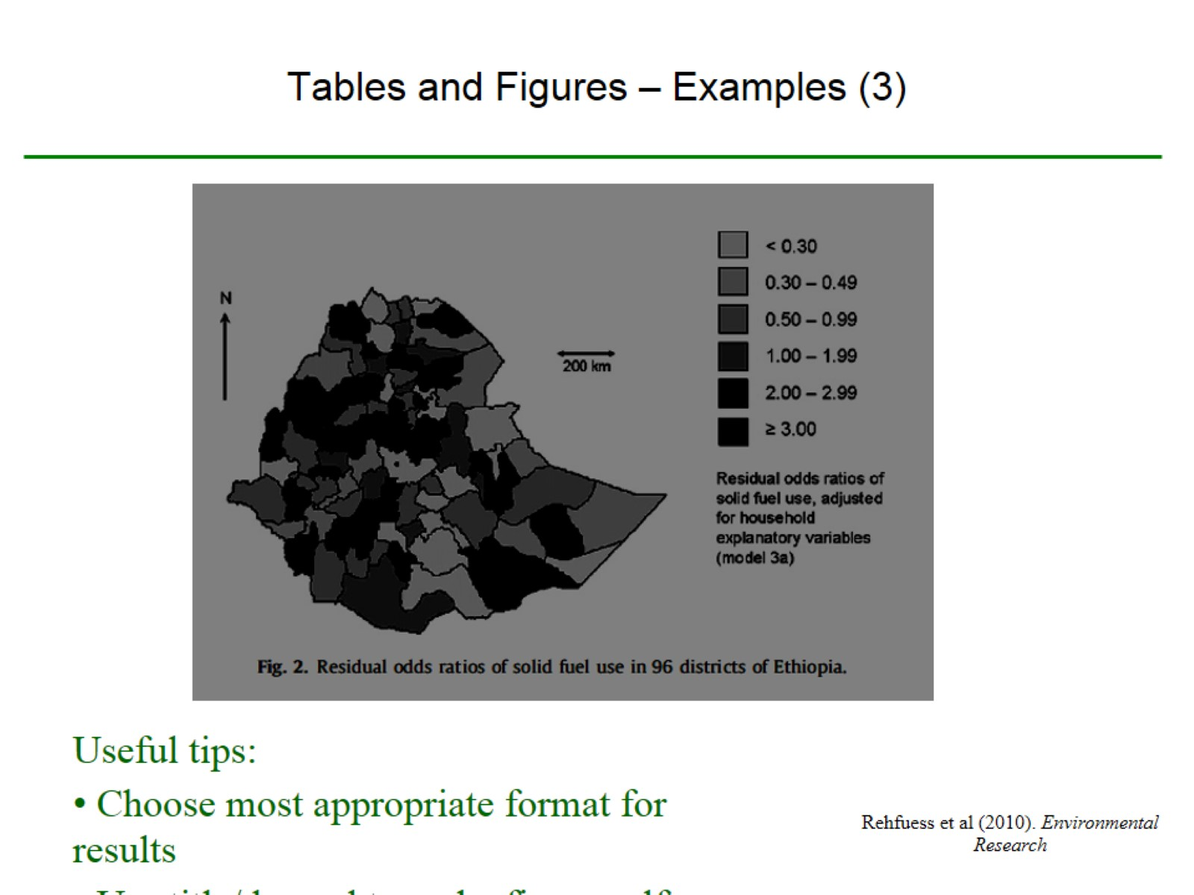
Tables and Figures – Examples (3)

Slide 17
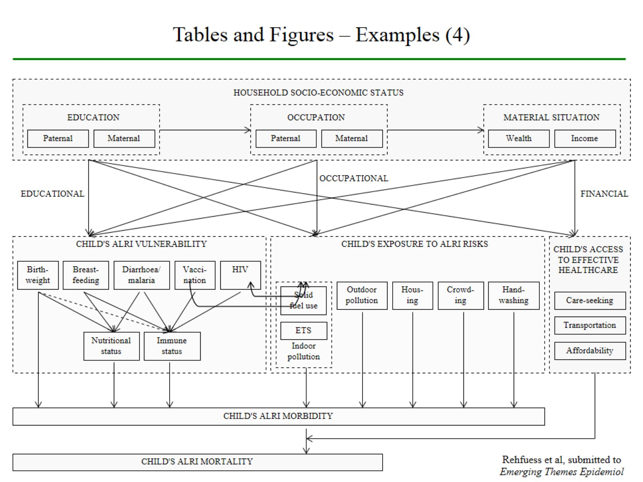

Slide 18
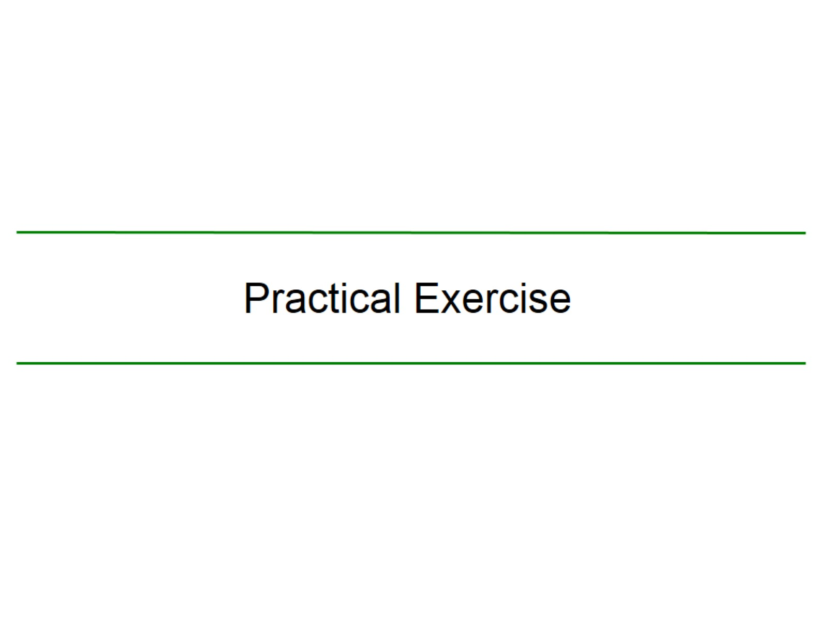
Practical Exercise

Slide 19
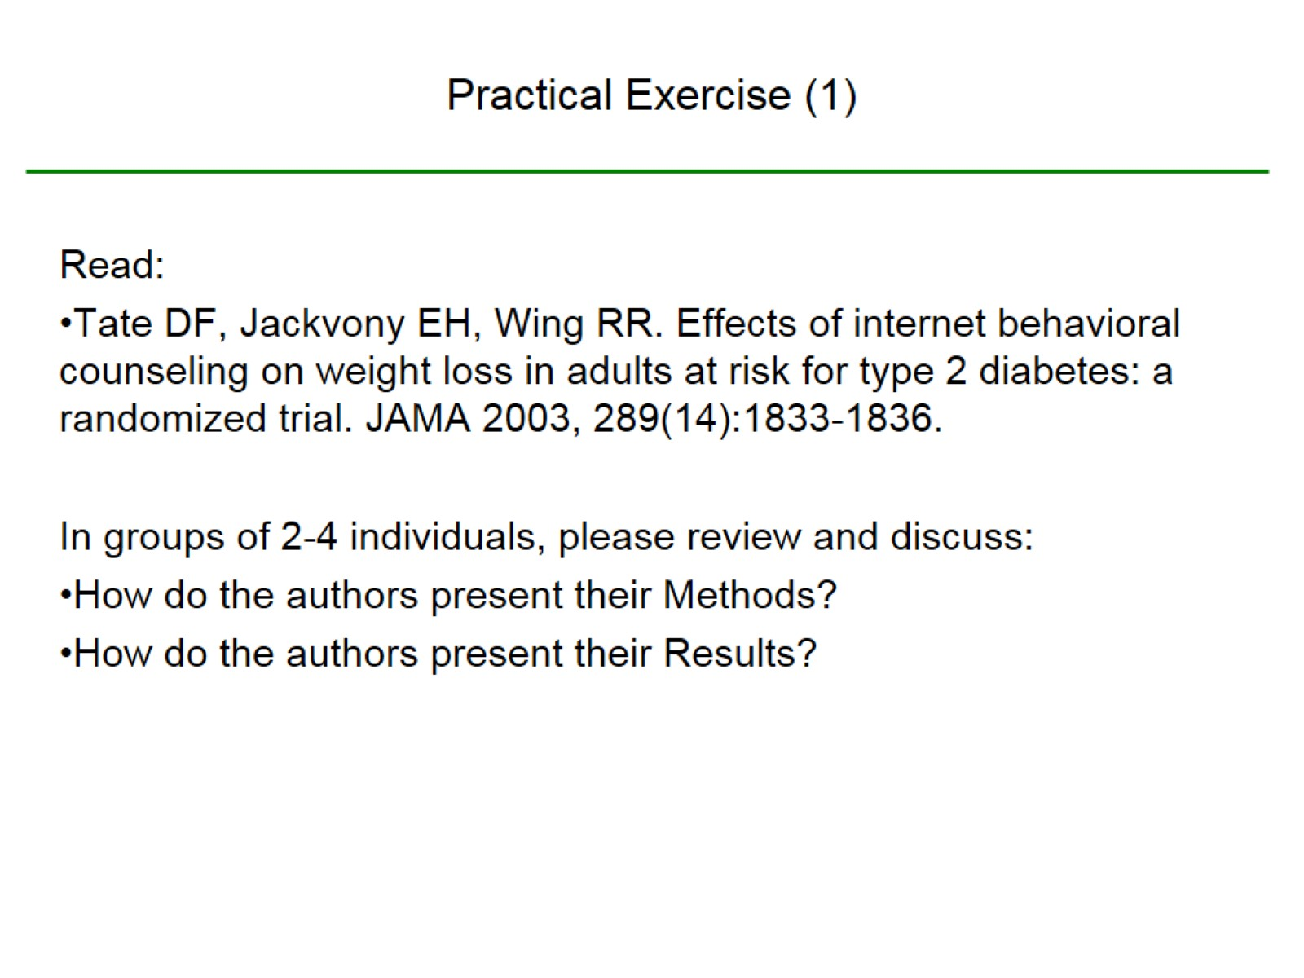
Practical Exercise (1)

Slide 20
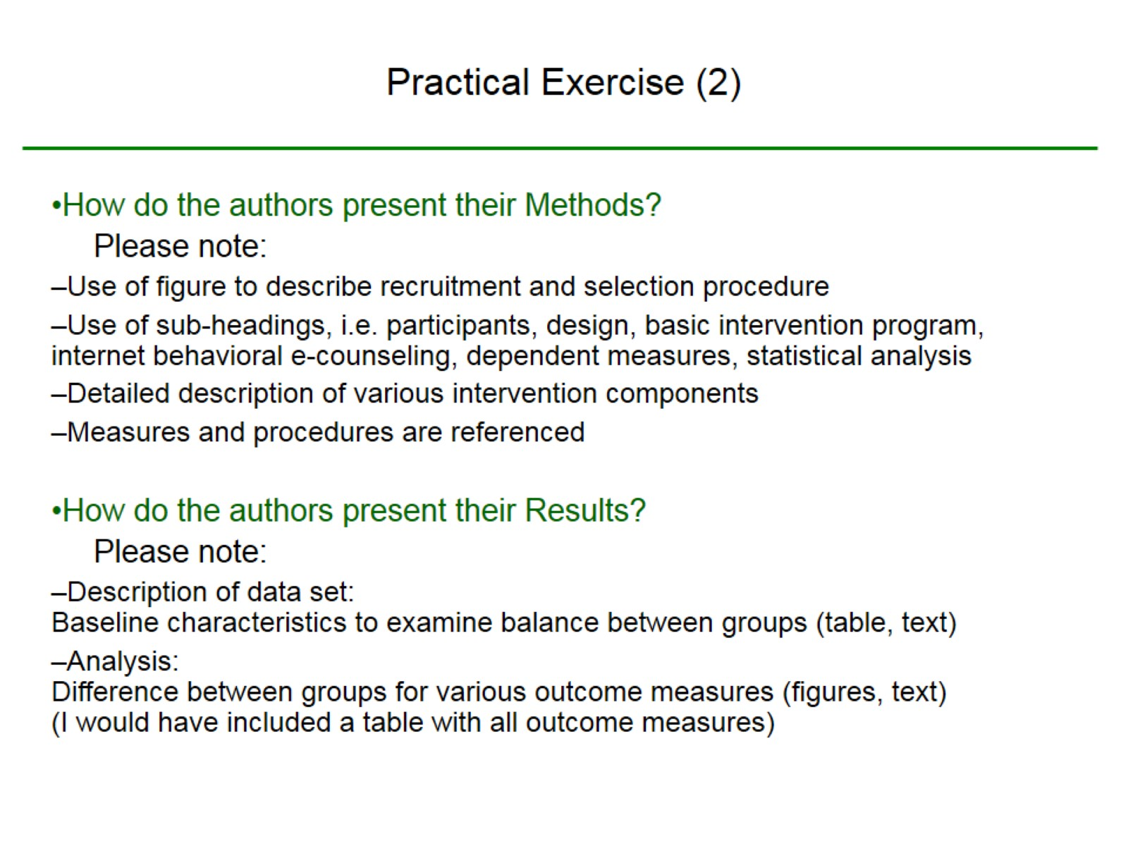
Practical Exercise (2)

Slide 21
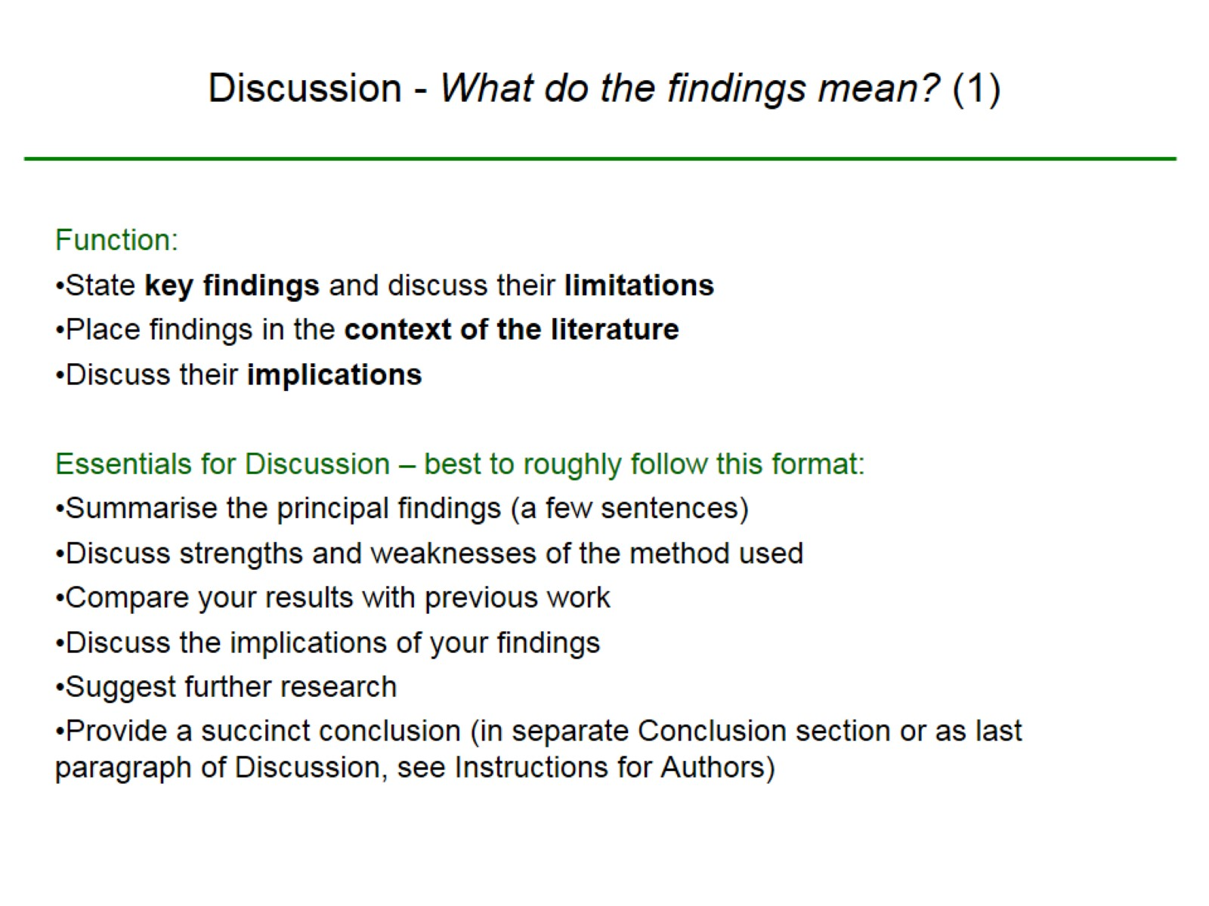
Discussion - What do the findings mean? (1)

Slide 22
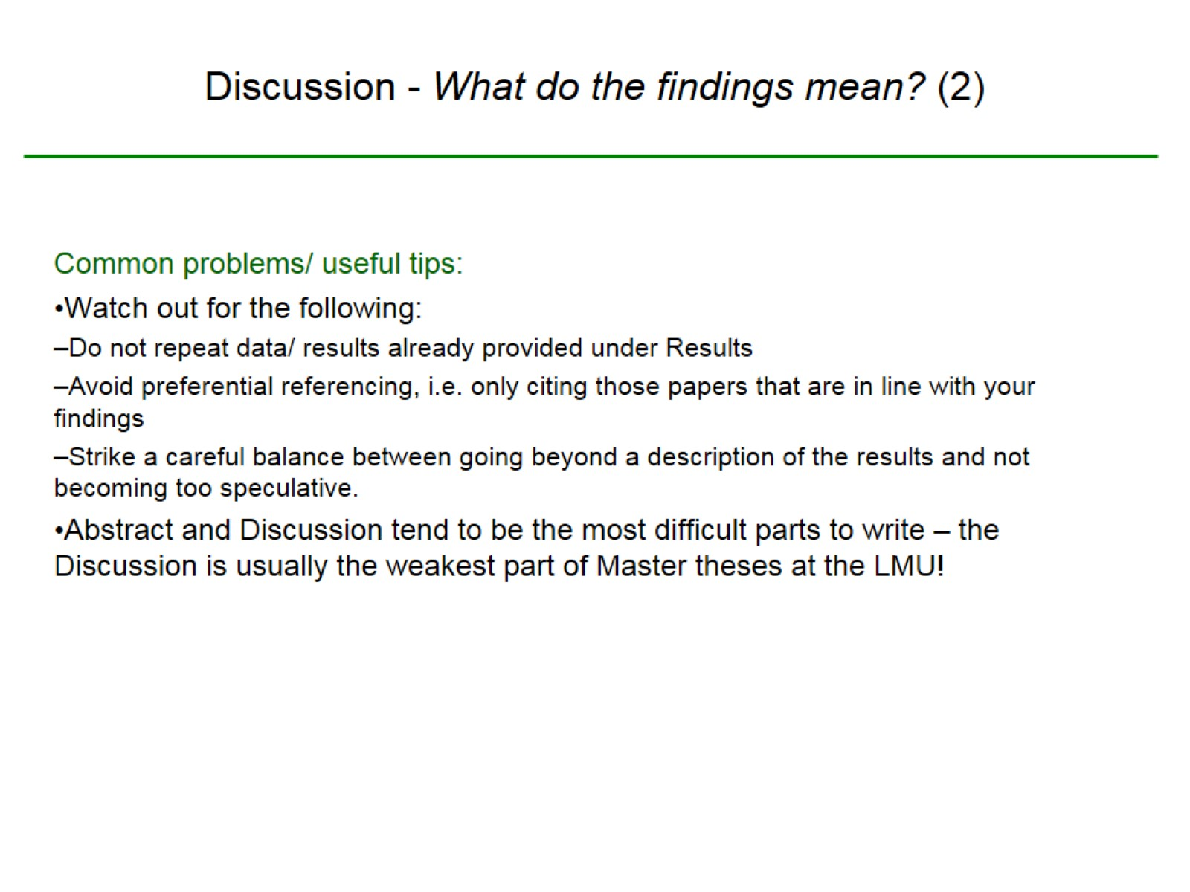
Discussion - What do the findings mean? (2)

Slide 23
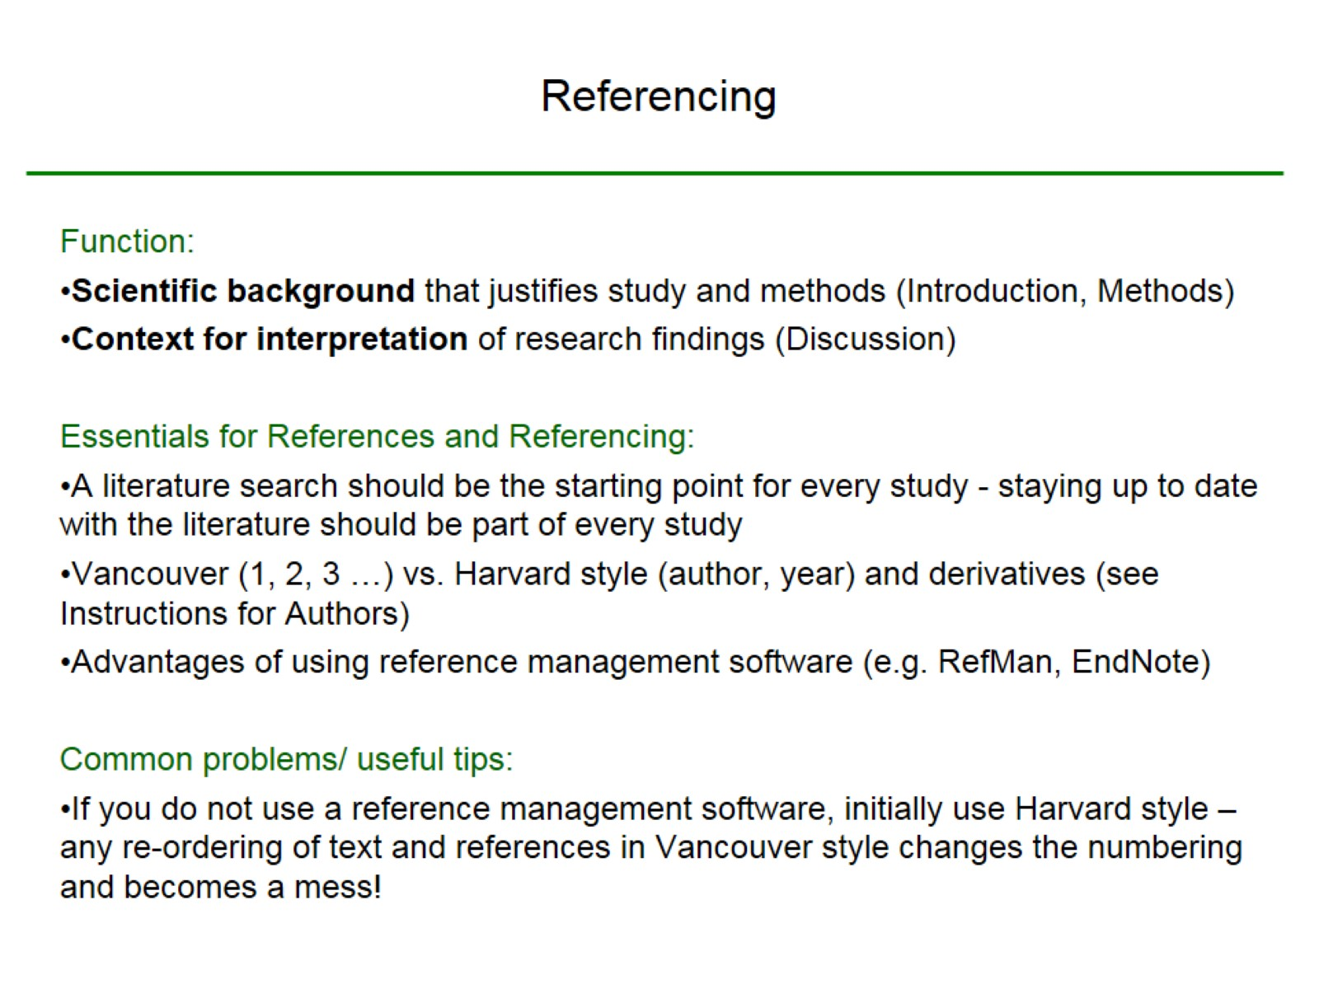
Referencing

Slide 24
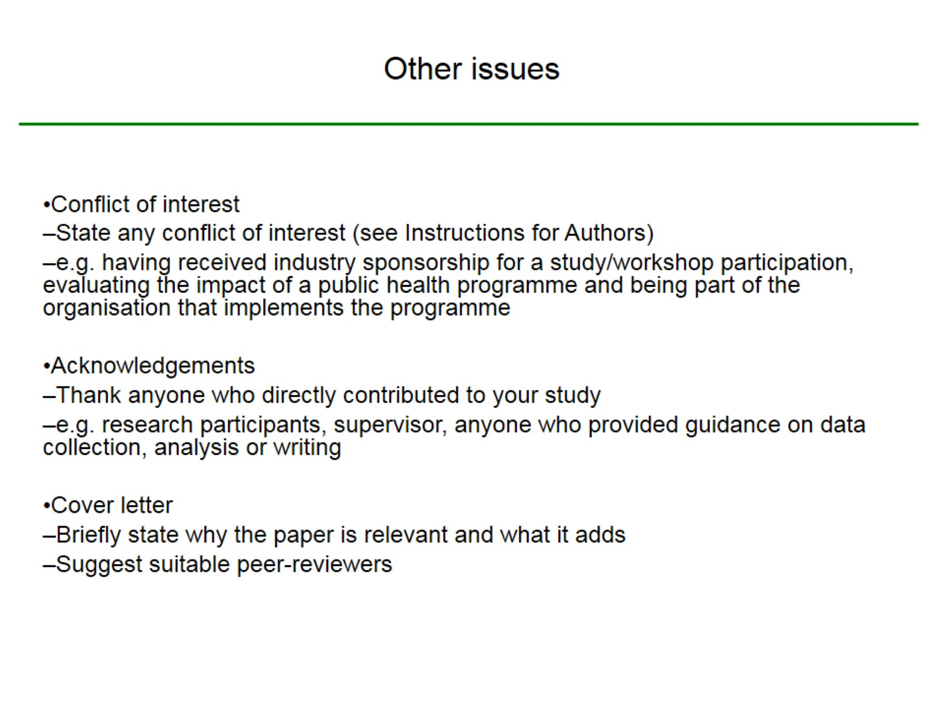
Other issues

Slide 25
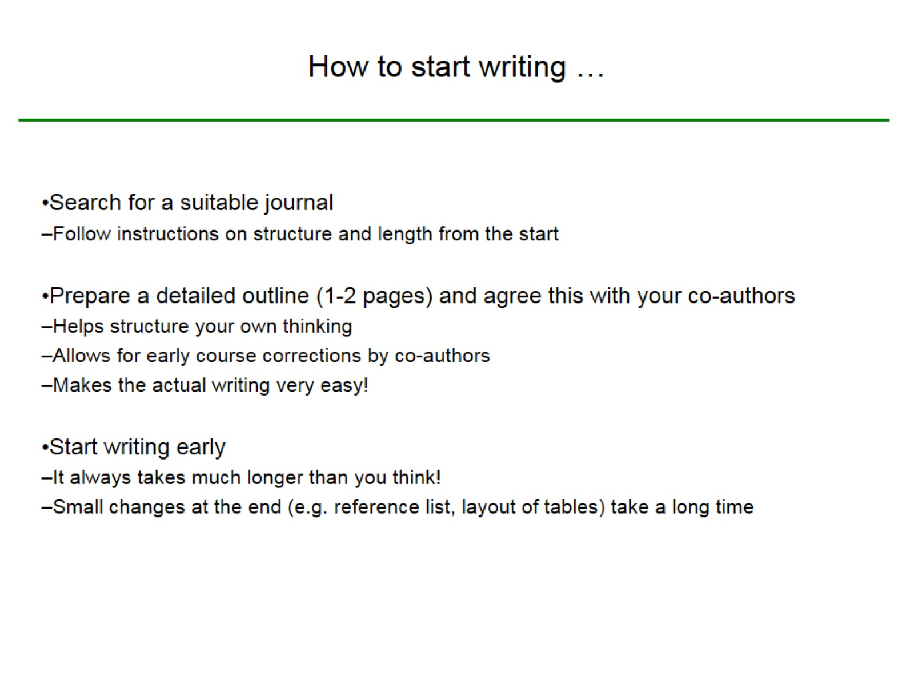
How to start writing …

Slide 26
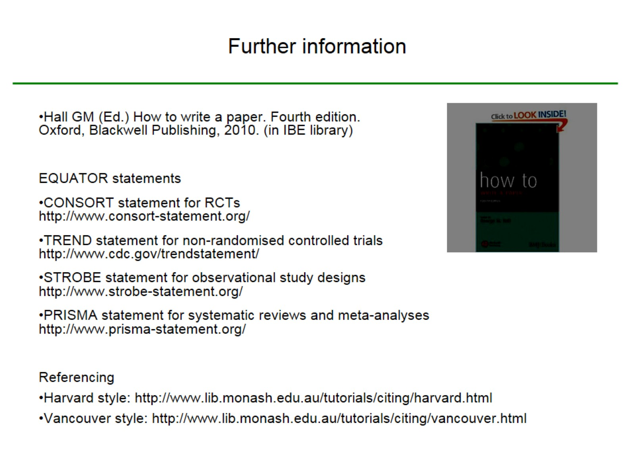
Further information

